Slide 1
CS 4530: Fundamentals of Software Engineering Module 03: Test Adequacy
Jonathan Bell, Adeel Bhutta, Mitch Wand
Khoury College of Computer Sciences
© 2023-24 Released under the CC BY-SA license

Slide 2
When have I written enough tests?
Notes:
This module is devoted to a single question: When have I written enough tests?
Last time, we talked about the important role of testing as a way of communicating the intended behavior of your program. In this module, we'll think about when you've done a good enough job at that.

Slide 3
Module Outline
Lesson 3.1 Writing tests for TDD
Lesson 3.2 Assessing Test Coverage
Lesson 3.3 Adversarial Coverage Testing
Notes:
This module is divided into 3 lessons: <read slide>

Slide 4
Learning Objectives for this Module
By the end of this lesson, you should be able to:
Explain different reasons why you might want to test
Design a TDD test suite by identifying equivalence classes of inputs
Explain the following measures of code coverage, and how they differ:
Statement or line coverage
Branch coverage
Path coverage
Use mutation testing to judge the completeness of a test suite
Notes:
<read slide>

Slide 5
Why do we test?
Test Driven Development
Does the SUT satisfy its specification?
“Good” test suite exercises the entire specification
Regression Testing
Did something change since some previous version?
Prevent bugs from (re-)entering during maintenance.
“Good” test suite detects bugs that we introduce in code
Acceptance Testing
Does the SUT satisfy the customer
“Good” test suite answers: Are we building the right system ?
Notes:
<read slide> . <click> Our focus is on testing as part of the test-driven development process.

Slide 6
CS 4530: Fundamentals of Software Engineering Lesson 3.1 Writing tests for TDD
Jonathan Bell, Adeel Bhutta, Mitch Wand
Khoury College of Computer Sciences
© 2023-24 Released under the CC BY-SA license
Notes:
OK, let's dive in.

Slide 7
What makes for a good test (suite)?
Desirable properties of test suites:
Find bugs
Run automatically
Are relatively cheap to run
Don't depend on the order of tests.
Desirable properties of individual tests:
Understandable and debuggable
No false alarms (not “flaky”)
Related Terminology: “test smells”
Notes:
<read slide>
Discuss: Are there any other qualities for a “good” test?

Slide 8
Building Tests from Specifications (TDD)
The real specification is often implicit.
When delivering a feature, it is important to deliver tests to ensure that the feature keeps working this way in the future
You may have specific domain knowledge that future developers who touch the code do not
Specifications are hard to interpret and check, automated tests are easy
Beyoncé rule: “If you liked it you should have put a ring test on it” (SoftEng @ Google)
Notes:
The assumption behind test-driven specification is that the real specification is often not written out explicitly or precisely, so often the tests are the most effective documentation of that unwritten spec.
This leads to the Beyonce rule: "if you liked it you should have put a test on it". This rule recognizes that often the tests *are* the specification.

Slide 9
Building Test Suites From Specifications (TDD)
First task is to enumerate the different classes of behaviors in the specification.
Example:
Requesting the transcript for a student ID.
Two cases:
The ID belongs to a student
The ID is not the ID of any student
The SUT should work similarly for all inputs in each case.
These cases are sometimes called "equivalence classes" of inputs.
Notes:
<read slide>

Slide 10

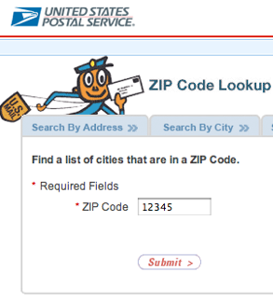
Example: Zip Code Lookup (1)
USPS ZIP code lookup tool accepts a zip code as input, and outputs:
The “place names” that correspond to that ZIP code, or
“Invalid zip code”
Strategy:
Determine the input equivalence classes, boundary conditions
Write tests for those inputs
Notes:
This highlights what we said before, about the importance of capturing domain knowledge. Not all 5 digit numbers are valid zip codes, some are reserved for future use.
Most interestingly, you may not be aware that there is a one-to-many relationship from zip codes to place names. A place name might be a city, or another name that the USPS historically accepts in place of a city. <Ask students if they know of any examples.> One is: 02120 -> Roxbury Crossing OR Boston OR Mission Hill OR Roxbury OR Roxbury Xing.
So the Beyonce rule applies: we'd better test some examples to see if our tool captures *all* of these.

Slide 11
Zip Code Lookup (2): Need to test all feasible inputs
Need to test behavior when the input is:
Not a 5 digit number
A 5 digit numbers
A valid ZIP code
With one place name
With multiple place names
Not a valid ZIP code
Test at least one input from each class, plus boundaries (e.g. 4 digit numbers, 6 digit numbers, no numbers)
Encode the expected output of the system for each test
All possible inputs
All 5 digit numbers
Valid ZIP codes
ZIP codes with multiple place names
Notes:
<READ SLIDE>

Slide 12
What does "all possible inputs" mean?
Should we also test with non-numeric inputs? With an empty input? With an input that isn't even a string?
Do we have to worry about the database going down?
All this depends on what we can assume about the system in which the lookup tool is embedded.
All possible inputs
All 5 digit numbers
Valid ZIP codes
ZIP codes with multiple place names
Notes:
<READ SLIDE>
Should we also test with non-numeric inputs? With an empty input? With an input that isn't even a string?
That depends on what we can assume about the system in which the lookup tool is embedded.

Slide 13
Cases for looking something up in a list
The list is empty
The thing you want is not in the list
The thing you want is the first thing in the list
The thing you want is the last thing in the list
The thing you want is in the middle of the list
Notes:
<read slide>

Slide 14
Example:
// find the first item in the list that is
// greater than or equal to the target.
// throw an error if none.
export default function search(list:number[], target:number) {
// NEED TO TEST WHAT GOES HERE
}
The list is empty
The thing you want is not in the list
The thing you want is the first thing in the list
The thing you want is the last thing in the list
The thing you want is in the middle of the list
Notes:
Discuss: give example inputs that cover each of these cases. Note that when we write the tests we don't know (or shouldn't know) what the body of this function looks like.

Slide 15
Example: TicTacToe
What are the possible states of a tictactoe game?
Board is full (draw)
Board is not full
Board not full, one player has won
Board not full, your turn
Board not full, the other person's turn
What are the possible inputs to the tictactoe game?
You move
The other player moves
Someone else tries to move
One of the players leaves the game
Notes:
Here are some equivalence classes for a tictactoe game. Making a list like this, on paper, before you actually write any of the tests, will help you make sure that you've covered all the possible cases.

Slide 16

Make sure you've covered the edge cases
Test at and near boundaries
Barely legal, barely illegal inputs
Less-than or less-than-or-equal?
Empty inputs?
Integer overflows / buffer overflows
Example: ComAir crew scheduling
problem due to a list getting more than 32767 elements
https://arstechnica.com/uncategorized/2004/12/4490-2/
Notes:
Typically, a greater number of errors occurs at the boundaries of an equivalence class rather than at the “center”.
Therefore, we specifically look for values that are at the boundaries. We call these "edge cases" or "corner cases".
If your input is a list, what if the list is empty?
Here's another example: ComAir's crew scheduling software (circa 2004, back in the days of 16-bit machines) assumed you'd never have more than 32767 crew changes in a single month. And in the middle of blizzard, that's exactly what happened! Oops!

Slide 17
But don't make unwarranted assumptions about the specification
Specifications often leave room for undefined behaviors: details that are subject to change
Brittle tests are tests that will fail unexpectedly if that undefined behavior changes
Notes:
<read slide>

Slide 18
Example: Is this particular error message required, or is it incidental?
test("should throw an error if no such item", () => {
const list = [1, 2, 3];
const target = 4;
expect(search(list, target)).toThrowError("No such item");
});
Notes:
Here's an example. Should we make this particular error message part of the specification? Or is this an example of over-specification? Discuss.

Slide 19
What does it mean for a test to succeed?
Test Oracles define the criteria for a test to suceedPossible kinds of test oracles
Function returns the exact “right” answer
Function returns an acceptable answer
Returns the same value as last time
Function returns without crashing
Function crashes (as expected)
Function has the right effects on its environment
Notes:
Let's change the subject a little. When we write a test, what are we testing for? What does it mean for a test to succeed? We call the part of the test that checks for the correct behavior the “oracle”. (Read slide)
But watch out for that last one….

Slide 20
Your module may interact with uncontrollable things in the environment
Network
Resources
The SUT
Mo
Human User
Database
Notes:
If your module is supposed to return an answer, then the kinds of tests we've written so far will suffice.
OTOH, the goal of our module might be to have some effect on a human user (via a web display or console.log), on the network (via http calls or the like), or on some external database. We may not be able to directly observe the effect of our module on any of these. Worse yet, the effects of our module take place in the real world, where we probably can’t undo them. This is all bad.
If you are working on a system which sends an email to customer after an operation, how will you test it? You don’t want to send a real email every time you test.

Slide 21
Test doubles replace uncontrollable things with things that you do control
Network
Resources
The SUT
Mo
Human User
Database
Notes:
One solution to this dilemma is to use a test double. A test double is a thing that looks like the real thing to the SUT but it is not real.
If you are working on a system which sends an email to customer after an operation, how will you test it? Instead of sending a real email every time you test, use a test double (a mock mail service).

Slide 22
Test Doubles Intercept Calls to Methods
Testing frameworks provide two common abstractions for doubles.
In Jest, these are called mocks and spies.
Other frameworks use terms like "fake" and "stub" for variants of these.
We'll discuss these in more detail in a later module.
Notes:
<read slide>

Slide 23
CS 4530: Fundamentals of Software Engineering Module 03.2 Measures of Test Coverage
Jonathan Bell, Adeel Bhutta, Mitch Wand
Khoury College of Computer Sciences
© 2023-24 Released under the CC BY-SA license

Slide 24
When have I written enough tests?
Hard to verify that your tests cover the whole specification
Especially if the specification is only in someone's head!
But easier to verify that your tests cover all of your code.
This is called "Code Coverage"
Coverage gives a quantitative measure of how much of your code is exercised by your tests
If the code isn't exercised, it's definitely not tested!
Notes:
Let's return to the main subject of this lecture: "When have I written enough tests?"
Previously, we assumed that we did not know anything about the implementation (except for the names of things). But once you have an implementation, you have more information available, and we can use that information to look more closely at the question of whether you've written all the tests you need.
In particular, we can check to see whether your tests test all of your code. This is called "code coverage"
If the code isn't run by any of your tests, then it's definitely not tested.
<no need to read slide>

Slide 25
Measures of code coverage
Statement or Block coverage
Branch coverage
Path coverage
Notes:
There are many different measures of code coverage. Here are three: <read slide>

Slide 26
Statement Coverage
Each line (or part of) the code should be executed at least once in the test suite
Adequacy criterion: each statement must be executed at least once
Statement Coverage: # executed statements # statements
Notes:
Statement coverage is the percentage of statements exercised by the test suite. A similar notion is "line coverage." This is the crudest measure of coverage.

Slide 27
Branch Coverage
Adequacy criterion: each branch in the control-flow graph must be executed at least once
coverage: # executed branches # branches
Subsumes statement testing criterion because traversing all edges implies traversing all nodes
Most widely used criterion in industry
Notes:
A better criterion is the branch testing criterion, which states that each branch in the CFG should be executed at least once.
We say that the branch testing criterion subsumes the statement testing criterion
…because if a test suite satisfies the branch testing criterion for a given program, then it also satisfies the statement testing criterion for that program

Slide 28

Tools for measuring coverage
Coverage is computed automatically while the tests execute
jest --coverage
Makes it easy
*see example at https://github.com/philipbeel/example-typescript-nyc-mocha-coverage
Notes:
Many forms of coverage can be computed automatically using automated tools
This is typically done by instrumenting the program so that whenever a statement/block is executed, a corresponding counter is updated.
For us, jest --coverage will do the job nicely.
Other languages have similar tools.

Slide 29
Executing every branch doesn't mean that you've executed every behavior
In this example, all branches are covered by the test
T1 covers the true branches
T2 covers the false branches
BUT: this function will crash if x = 0, y = 1
x=0, y=1
function magic(x: number, y: number) {
let z = 0;
if (x !== 0) {
z = x + 10;
} else {
z = 0;
}
if (y > 0) {
return y / z;
} else {
return x;
}
}
test(“100% branch coverage", () => {
expect(magic(1, 22)).toBe(2); //T1
expect(magic(0, -10)).toBe(0); //T2
});
✅ T1
✅ T2
✅ T1
✅ T2
Notes:
(Read bullets, then click one-by-one to show all 4 branches covered. The bug is if (x == 0 and y > 0)
A stronger criteria would be “path” coverage, which would say that in this case, we need to execute all combinations of the branches.
(Note: the arrow from z =0 to y > 0 is incorrectly animated, but I didn't have time to fix it ☹ --MW)

Slide 30
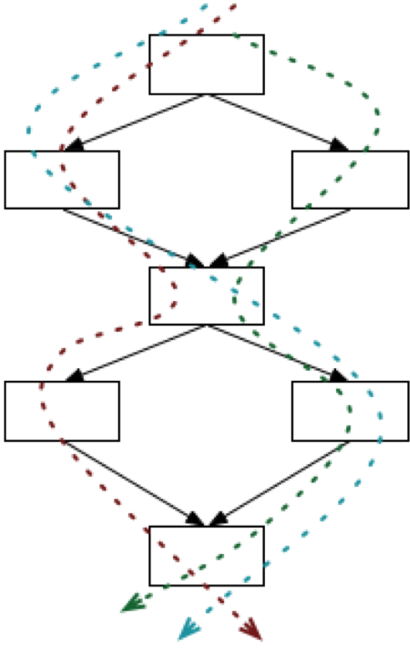
Code like this will make path coverage hard to achieve
n tests might lead to 2^n paths
Sometimes a fault is only manifest on a particular path, as we saw in the preceding example.
Worse, the number of paths can be infinite
E.g., if there is a loop.
What to do?
Notes:
The next testing criterion we consider is path testing.
The number of paths can be exponential in the number of branches, as it was in the preceding example.
Worse yet, in the presence of things like for-loops, the number of paths may be infinite.
Discuss: How would you test the code with loops in it?
Typical workaround: Modify the code to keep a count of the number of times the loop has been executed, and put a limit on the number of times through the loop. What happens if we run the loop 0 times, 1 time, 2 times? Maybe choose a large but realistic value for the bound.

Slide 31
Smarter tools can rule out unreachable paths
Looks like there might be 4 paths: AC AD BC BD
But maybe not all of these are feasible.
Depends on the details of what's in E1 and E2.
Let's say that the path AD leads to an error.
Crude analysis considers all possibilities.
Better idea: Is it possible for E1() to be true and E2() to be false?
Automatic theorem-proving can often show that this is impossible.
if (E1()) {A()}
else {B()};
if (E2()) {C()}
else {D()}
Notes:
Maybe we can defeat this exponential blow up by having smarter tools. <read slide>

Slide 32
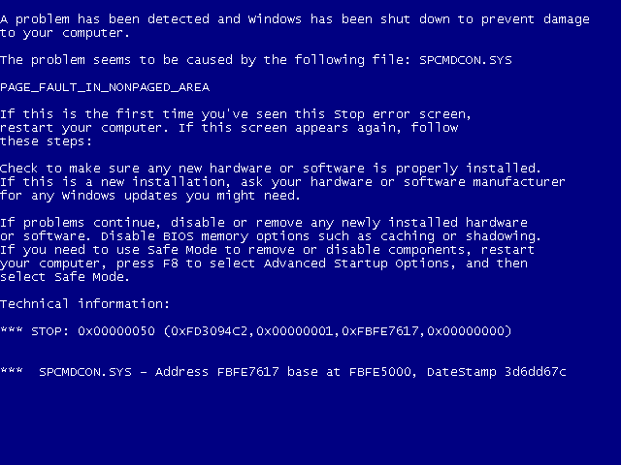
The Blue Screen of Death
Eliminated by using SLAM tool (2001-2011)
https://cacm.acm.org/magazines/2011/7/109893-a-decade-of-software-model-checking-with-slam/fulltext
Notes:
Here's the much-feared Blue Screen of Death (how many of you have actually seen one of these).
<Discuss>
These used to come up whenever a Windows device driver crashed, which used to be pretty often.
<click>
But it was eliminated when Microsoft inserted a smart analysis tool (called SLAM/BLAST) into its development toolchain. They required all driver code to pass this test-- many of you are too young to have seen one of these!

Slide 33
CS 4530: Fundamentals of Software Engineering Lesson 3.3 Adversarial Testing
Jonathan Bell, Adeel Bhutta, Mitch Wand
Khoury College of Computer Sciences
© 2023-24 Released under the CC BY-SA license
Notes:
This brings us to Lesson 3.3: Adversarial testing. This is yet another way of judging whether you have written enough tests.

Slide 34
Adversarial testing is a way of judging whether you have written enough tests.
It is helpful to think of adversarial testing as a game in which you play against an adversary
In adversarial testing, the adversary generates a set of “mutants” – buggy versions of a reference solution.
You win against the adversary if your tests reject all of the mutants.

Slide 35
One could, in principle, generate the mutants by hand
Strawman - “Seeded Faults”:
Create N variations of the codebase, each with a single manually-written defect
Evaluate the number of defects detected by test suite
Test suite is “good” if it finds all of the defects you thought to introduce.
But:
Did we introduce realistic defects?
Clearly doesn't scale!
Notes:
(Read slide, then discuss)
Note that the strawman is probably something that we should do for particular faults that we really want to make sure we are testing for, and it is a good strategy to have in your back pocket. But, there are definitely problems with applying this at scale…
* *very* time intensive to inject bugs
Do we write realistic bugs? (eg, "sort everything except arrays of length 42")
Do we inject all of the possible bugs? No idea whether the bugs we inject manually cover the likely bugs.

Slide 36

In mutation testing, the adversary generates buggy code by making simple changes
// find the first item in the list that is
// greater than or equal to the target.
export default function search(list:number[], target:number) {
return list.find((item) => item >= target);
}
Original code (correct)
// find the first item in the list that is
// greater than or equal to the target.
export default function search(list:number[], target:number) {
return list.find((item) => item > target);
}
Mutated code (buggy)
Notes:
The idea of "mutation testing" is that most defects are the result of simple errors. (Is this a realistic assumption? Spoiler alert: it's realistic enough!)
In mutation testing, the adversary generates buggy code by making simple changes. Generating buggy code in this way is clearly automatable.
Note that this is the kind of mistake that you might make if you were in a hurry, or tired, or it was late at night.
Snidely Whiplash (over there on the right) asks "can you tell the difference"?
(Recall that a while ago we promised you help in making sure that your regions have the right boundaries. This will help!)

Slide 37
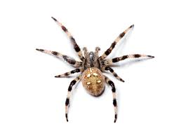
The Stryker Game: The Opening
Player (You)
Opponent (Them)
Your code
Mutant 1
Mutant 2
Your tests
Mutant 3
Notes:
The opponent starts by running your tests against your code (this is called the "dry run"). It then generates a set of modified versions of your code. These are called the "mutants". Some mutations introduce bugs (here, mutants 1 and 2). Some mutations may be benign (here mutant 3).

Slide 38

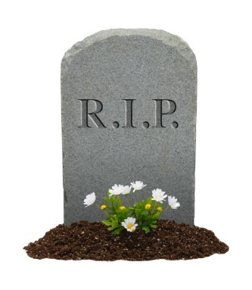

The Stryker Game: Result of one round of play
Player (You)
Opponent (Them)
Your code
Mutant 1
Mutant 2
Your tests
Mutant 3
Notes:
In each round of the game, your tests are run against each of the mutants. Your tests will reject some of the mutants-- they are definitely buggy because they don't pass your tests. We say those mutants are "dead".

Slide 39
The Stryker Game: Result of one round of play
Player (You)
Opponent (Them)
Your code
Mutant 1
Mutant 2
Your tests
Mutant 3
Notes:
But what about mutant #3? Remember that the opponent doesn't have a reference solution or reference tests, so some of the mutants they generate may be innocuous. You get to see exactly what was changed in mutant #3 (and any other surviving mutant), so you can inspect each surviving mutant by hand to decide.

Slide 40
The Stryker Game: a winning position
Player (You)
Opponent (Them)
Your code
Mutant 1
Mutant 2
Your tests
Hmm, now that you look closer, you see that mutant 3 isn't actually a bug.
Mutant 3
Notes:
<click>
Here, we imagine that you've decided that mutant #3 wasn't really bug: it was a change that doesn't affect the successful operation of your program.
You've killed all the buggy mutants, and all the survivors are harmless. You win!

Slide 41
The Stryker Game: a losing position
Player (You)
Opponent (Them)
Your code
Mutant 1
Mutant 2
Your tests
Hmm, mutant #3 really demonstrates a bug. Time to strengthen your tests
Mutant 3
Notes:
<click>
Alternatively, you could decide that the modification introduced in mutant 3 really was a bug. So you need to go back and modify your tests or write new tests to catch it.
And of course, then you go back to the beginning and run your new tests again, against the same set of mutants.

Slide 42
Remedy: you need to devise tests that distinguish the original code from the mutants
Devise a test that your original code will pass, but the mutant will fail.
Notes:
<read slide>

Slide 43
A tiny example
Imagine that this is the code to be tested
// find the first item in the list that is
// greater than or equal to the target.
export default function search(list:number[], target:number) {
return list.find((item) => item >= target);
}
and we have written some tests.
Notes:
Let's look at a tiny example. <Read Slide> Next, let's look at the Stryker report for this example.

Slide 44
Stryker report for this test
[Survived] EqualityOperator
src/for-midterm/adrian.ts:4:32
- return list.find((item) => item >= target);
+ return list.find((item) => item > target);
Tests ran:
search should return the first item in the list that is greater than or equal to the target
[Survived] ConditionalExpression
src/for-midterm/adrian.ts:4:32
- return list.find((item) => item >= target);
+ return list.find((item) => true);
Tests ran:
search should return the first item in the list that is greater than or equal to the target
Notes:
Let's look at each of these mutants in turn. Point out: the location of the mutation; the titles of the test(s) that covered this location (in this case, there was only one test, so they are both the same).

Slide 45
Let's look at the second one:
[Survived] ConditionalExpression
src/for-midterm/adrian.ts:4:32
- return list.find((item) => item >= target);
+ return list.find((item) => true);
Notes:
When do these code fragments behave differently? How could we give the program an input that makes the mutant fail?.
Discuss.
Ans: the mutant always returns the first element of the list. You could distinguish them by giving an input that should return some other element of the list

Slide 46
Here's one test that will cause the mutant to fail
test("should return the second element of the list", () => {
expect(search([5, 7, 9], 6)).toBe(7);
});

Slide 47
What about the other mutant?
[Survived] EqualityOperator
src/for-midterm/adrian.ts:4:32
- return list.find((item) => item >= target);
+ return list.find((item) => item > target);
Notes:
Under what conditions will these two program fragments behave differently? How could we write a test to create those conditions?
DISCUSS.
ANS: if the target is equal to one of the list items, the second one will keep going and return a different one.

Slide 48
Here's one test that make the mutant fail
test("try target that is equal to some item in the list", () => {
expect(search([5, 7, 9], 7)).toBe(7);
});
Notes:
We've made the mutant fail, but our correct program succeeds.

Slide 49
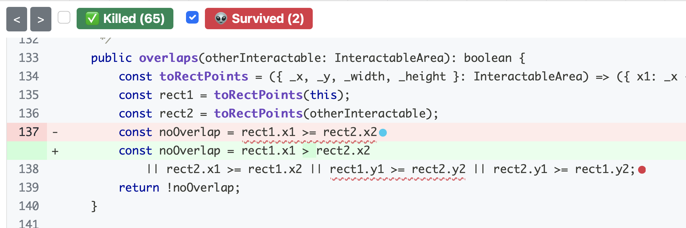
Use Mutation Analysis While Writing Tests
When you feel “done” writing tests, run a mutation analysis
Inspect undetected mutants, and try to write tests that will make those mutants fail.
Detailed mutation report for “overlaps” method - two mutants were not detected!
Notes:
Mutation analysis helps us improve our tests as we write them, because it shows us changes to our code (potential bugs!) that our tests do not detect. Remember, that to “detect” a mutant means that at least one test in your test suite fails when run on the mutated code.
This screenshot shows a mutation report from the tool Stryker, when run on an 'overlaps' method from Covey.town. In this screenshot, we can see an undetected mutant, on line 137. The red highlighting (with the minus sign) shows how the line was before the mutation, and the green highlighting (with the plus sign) shows the line after the mutation. In this case, the mutation was to replace a >= with a > sign.
There is also an undetected mutation on line 138, but it is not expanded (the red dot). When working through the report, you'll see them a single mutant at a time (because that’s what was run – one mutant at a time).
Was this a bug? I don't know, because I don't have enough context to decide ☺. But when you are running Stryker, you *will* know the context.

Slide 50
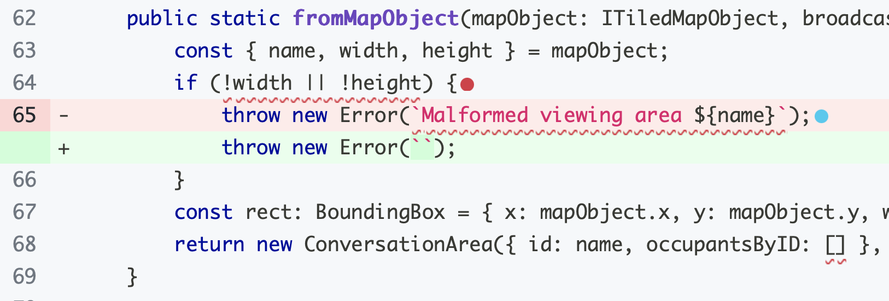
Undetected Mutants May Not Be Bugs
Unfortunately, we can't automatically tell if an undetected mutant is a bug or not
This mutant is benign: the specification didn't require this particular error message to be generated.
Testing for this message would be brittle
Notes:
We can not ever aim to achieve 100% mutation coverage (detect all of the mutants) because it is likely that not all mutants are bugs.
Here is a clear case of a benign mutant. However, sometimes it may be harder to tell-- you may have to think about whether the mutant actually changes the overall behavior of the program.

Slide 51

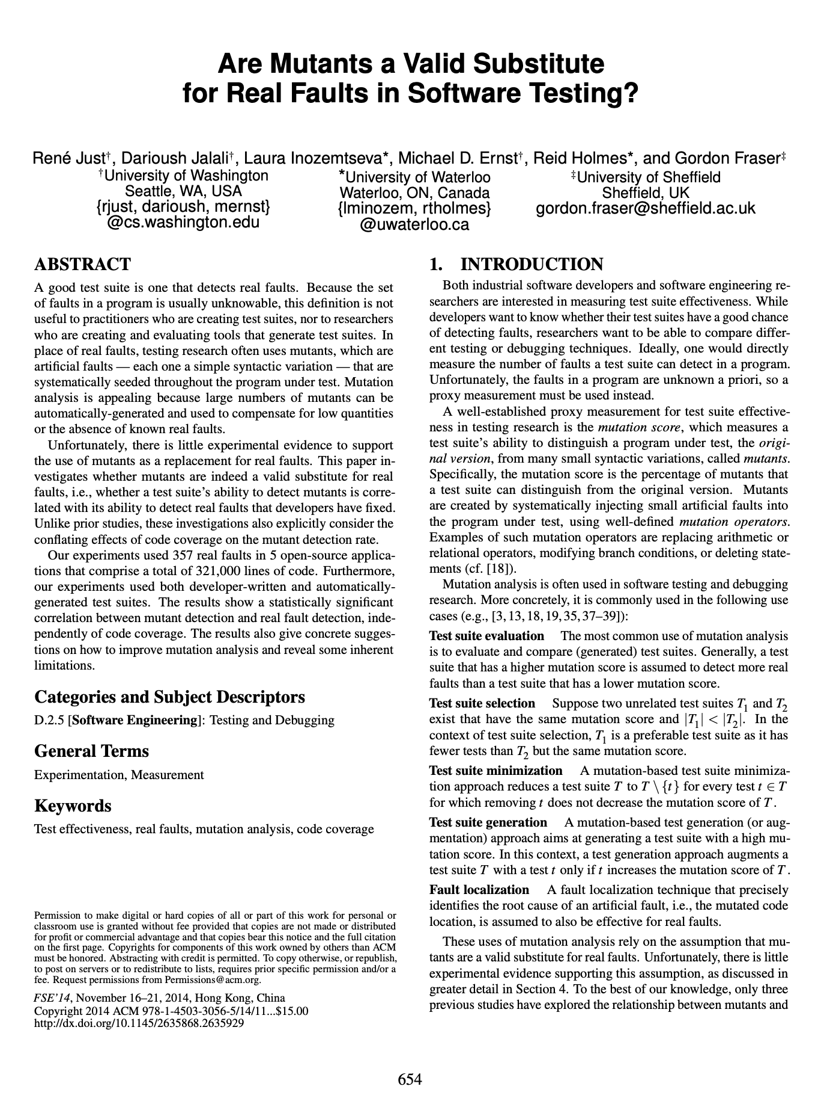
Are mutants a Valid Substitute for Real Faults? Probably yes.
Do mutants really represent real bugs?
Researchers have studied the question of whether a test suite that finds more mutants also finds more real faults
Conclusion: For the 357 real faults studied, yes
This work has been replicated in many other contexts, including with real faults from student code
Notes:
You might look at these mutants, which are caused by such simple operations, and wonder: but do these one-line mutations really represent the kinds of bugs that occur in real software? Because ultimately, that is what we are looking to evaluate, right? Do our tests find real bugs?
This study (and others that have replicated it) is important because it shows that this process of enhancing a test suite to detect more mutants might be worth the effort, because there is empirical evidence that: given two test suites, where one detects more mutants than the other (on the same SUT), the one that detects more mutants also finds more real bugs.

Slide 52
Activity: improving a test suite
Enhance the test suite of the transcript server to improve line coverage and mutation coverage
Download from Module 03 webpage

Slide 53
Review
Now that you have come to the end of this lesson, you should be able to:
Explain different reasons why you might want to test
Design a TDD test suite by identifying equivalence classes of inputs
Explain the following measures of code coverage, and how they differ:
Statement or line coverage
Branch coverage
Path coverage
Use mutation testing to judge the completeness of a test suite
Notes:
<read slide>

